Slide 1

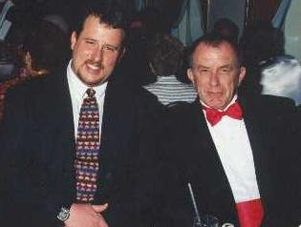
Exposure CS 2021
for CS1
Chapter 9
Output Slides
For Students
PowerPoint Presentation
created by:
Mr. John L. M. Schram
and Mr. Leon Schram
Authors of Exposure
Computer Science

Slide 2
Output Programs
These slides will present a variety of small programs. Most of the programs deal with calling subroutines (procedures and functions) and passing arguments to parameters.
Our concern will be with the output of each program, and more importantly, developing a way to determine program output correctly for programs that involve one or more user-created subroutines.
You can expect that on quizzes and/or tests only a program segment or a subroutine is shown.

Slide 3

Teacher/Student Versions, Tablet PCs, and Inking
The “For Teachers” version of this presentation has 2 slides for each program.
The first slide only shows the program.
The second shows the program, worked out solution, and output.
The “For Students” version
only has 1 slide for each
program with no provided
solution or output. Students are
expected to work out the solutions either on paper, or ideally they can “ink” directly on their laptops.

Slide 4
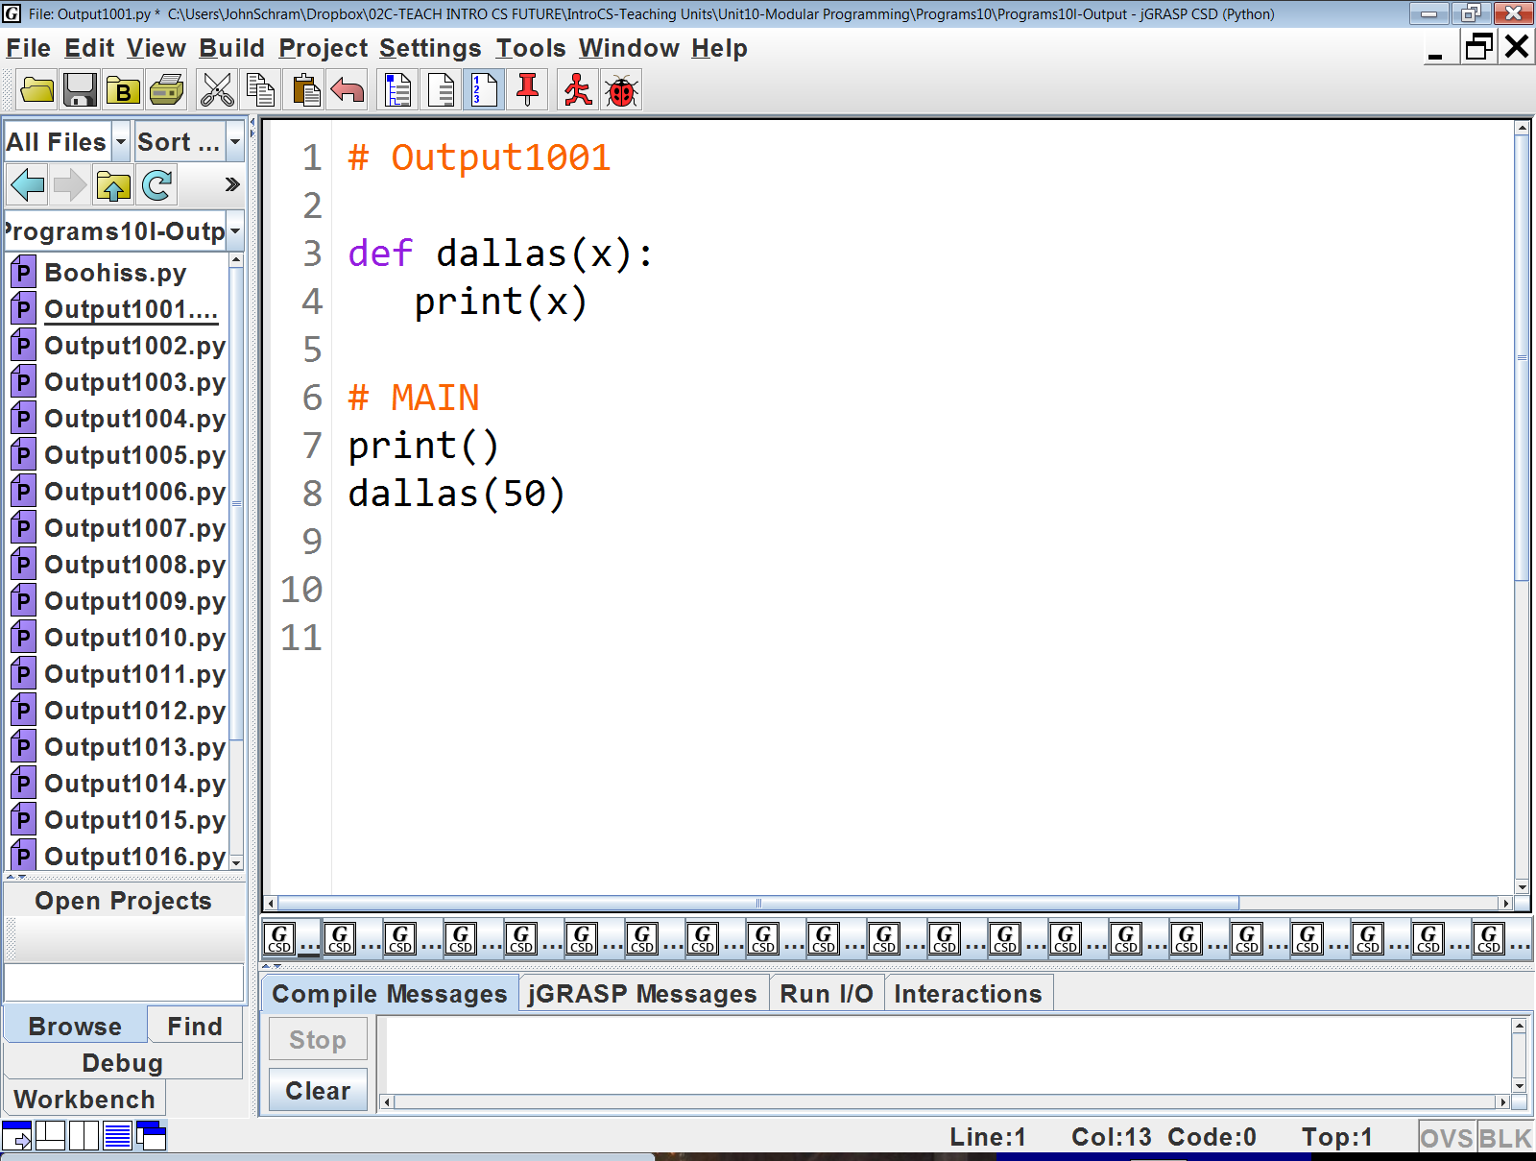
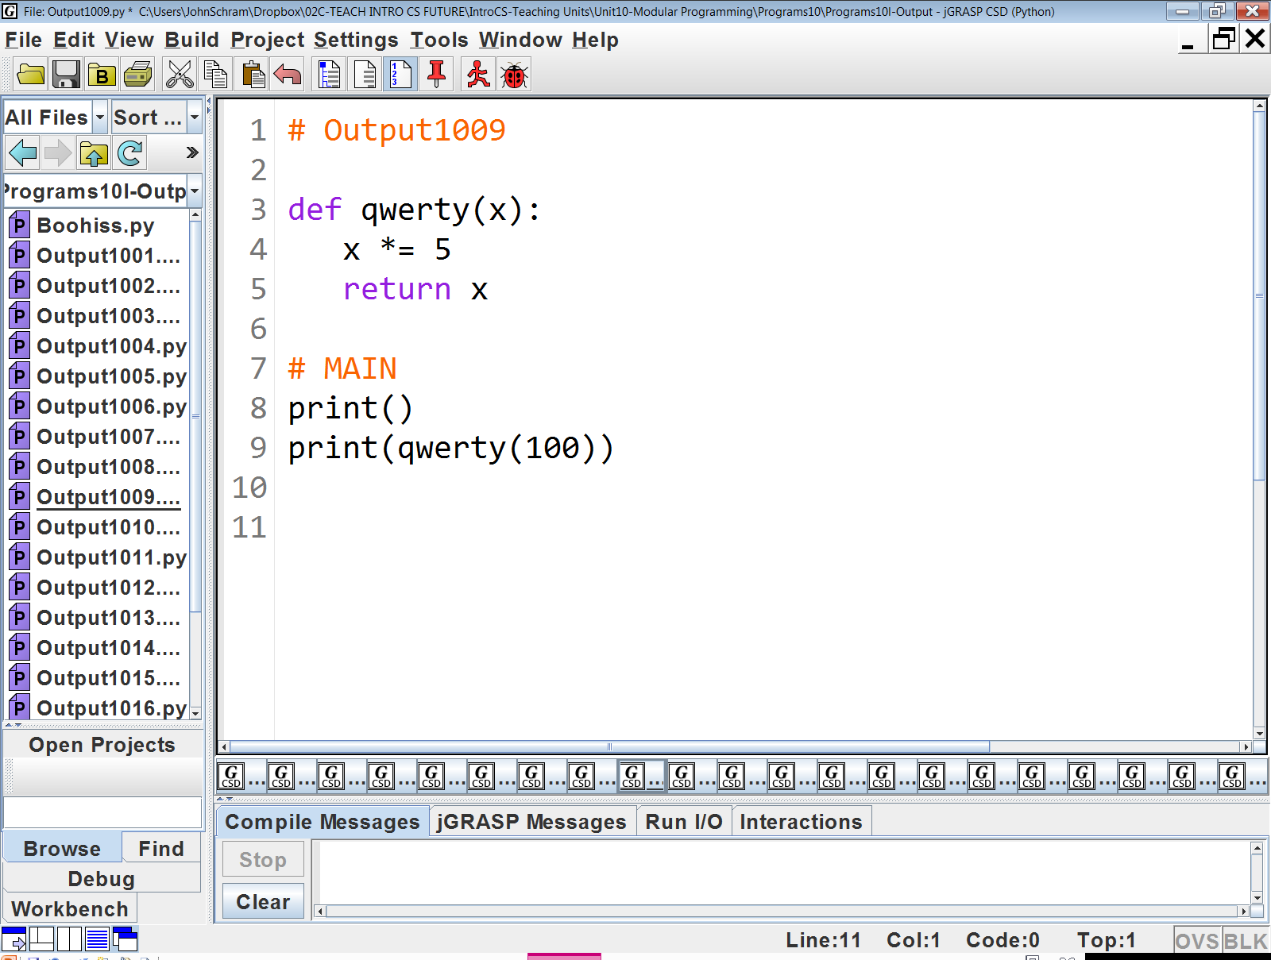

Slide 5
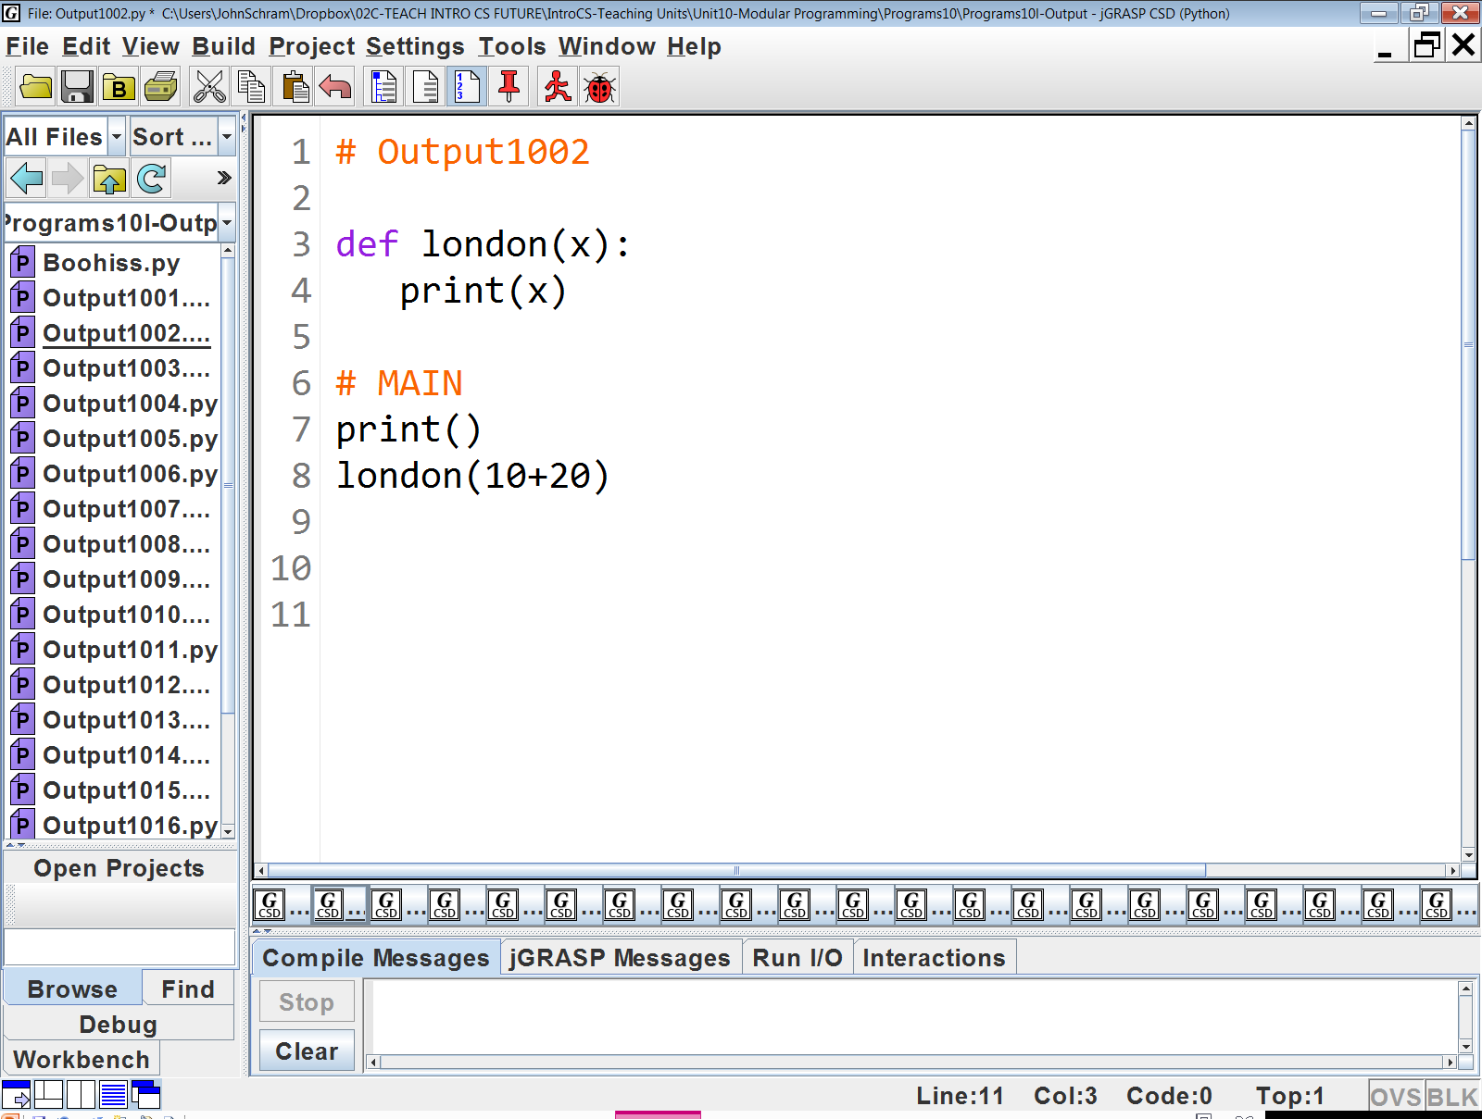

Slide 6
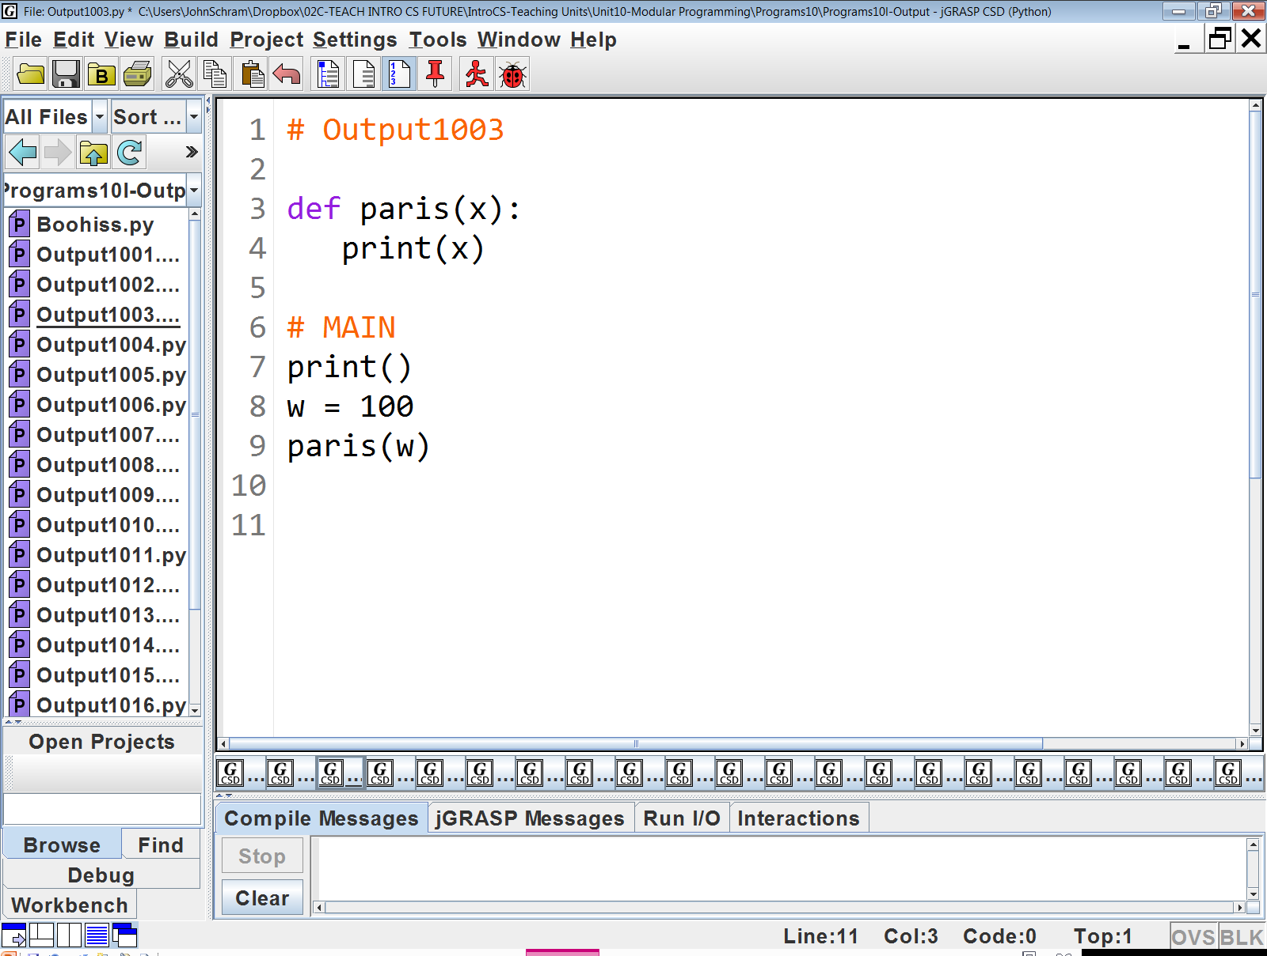

Slide 7
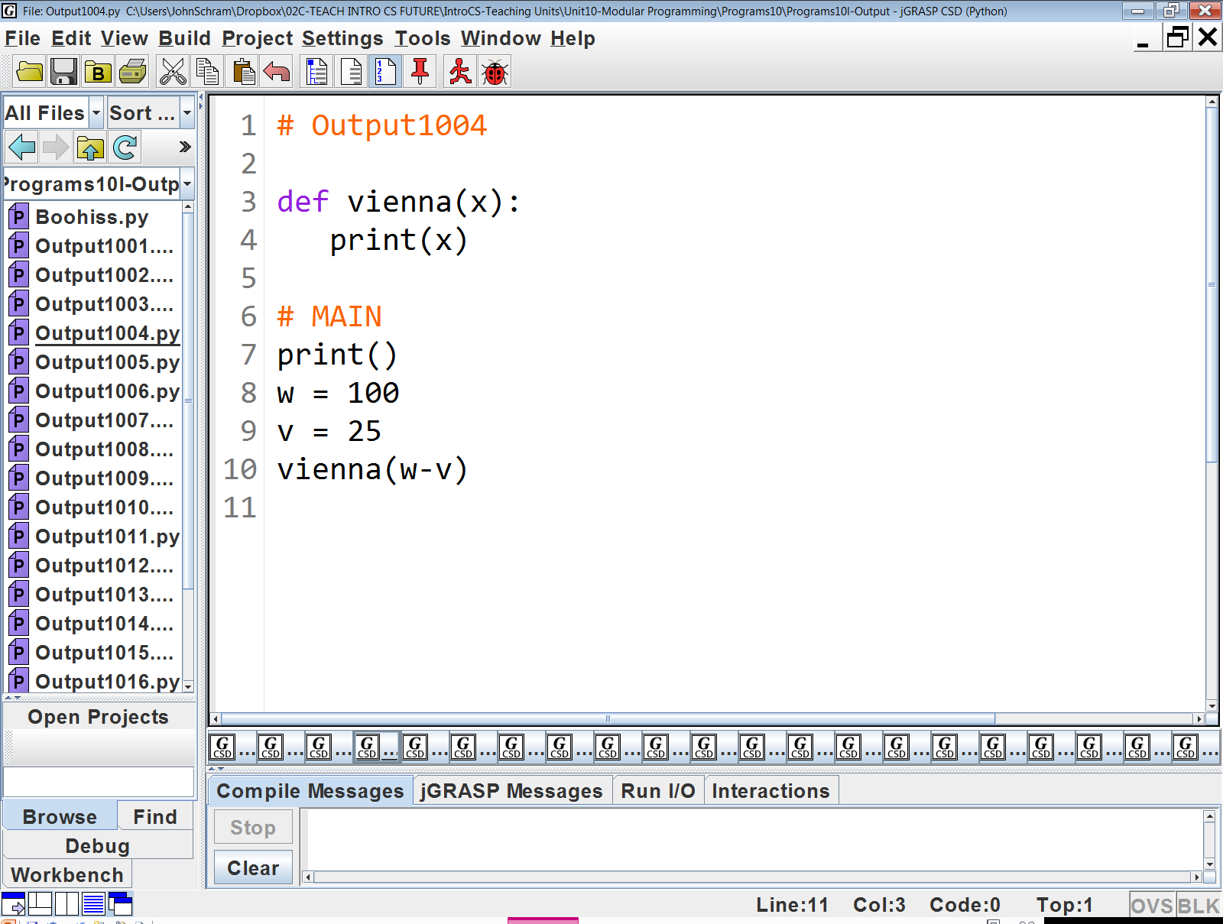

Slide 8
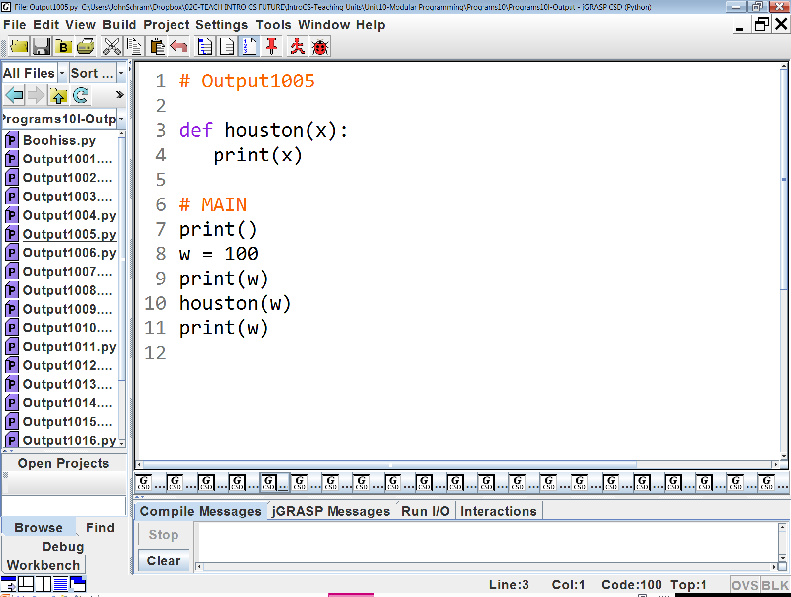

Slide 9
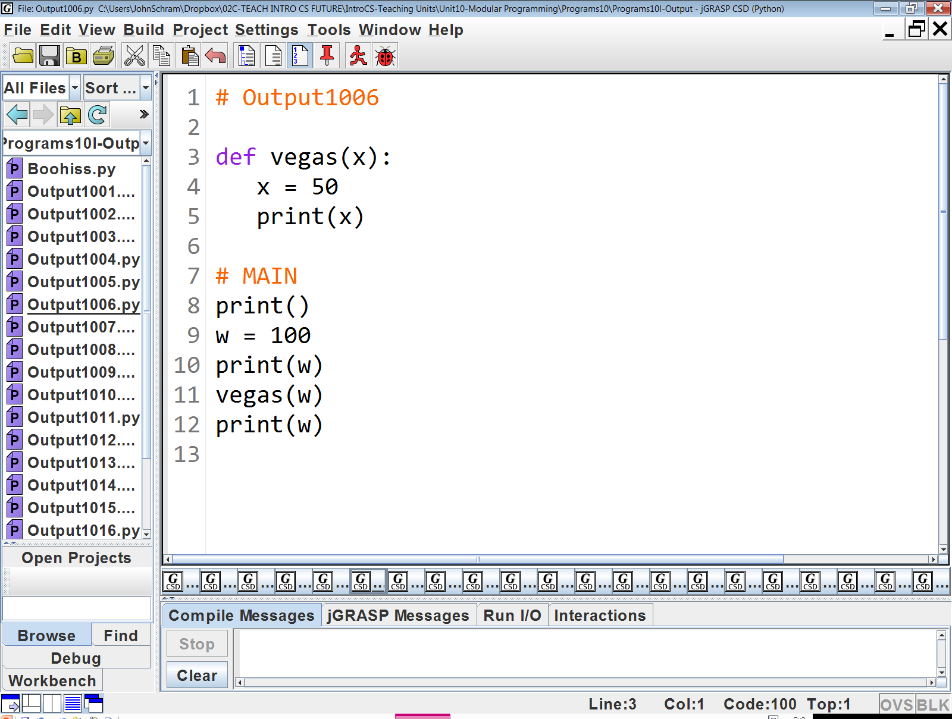

Slide 10
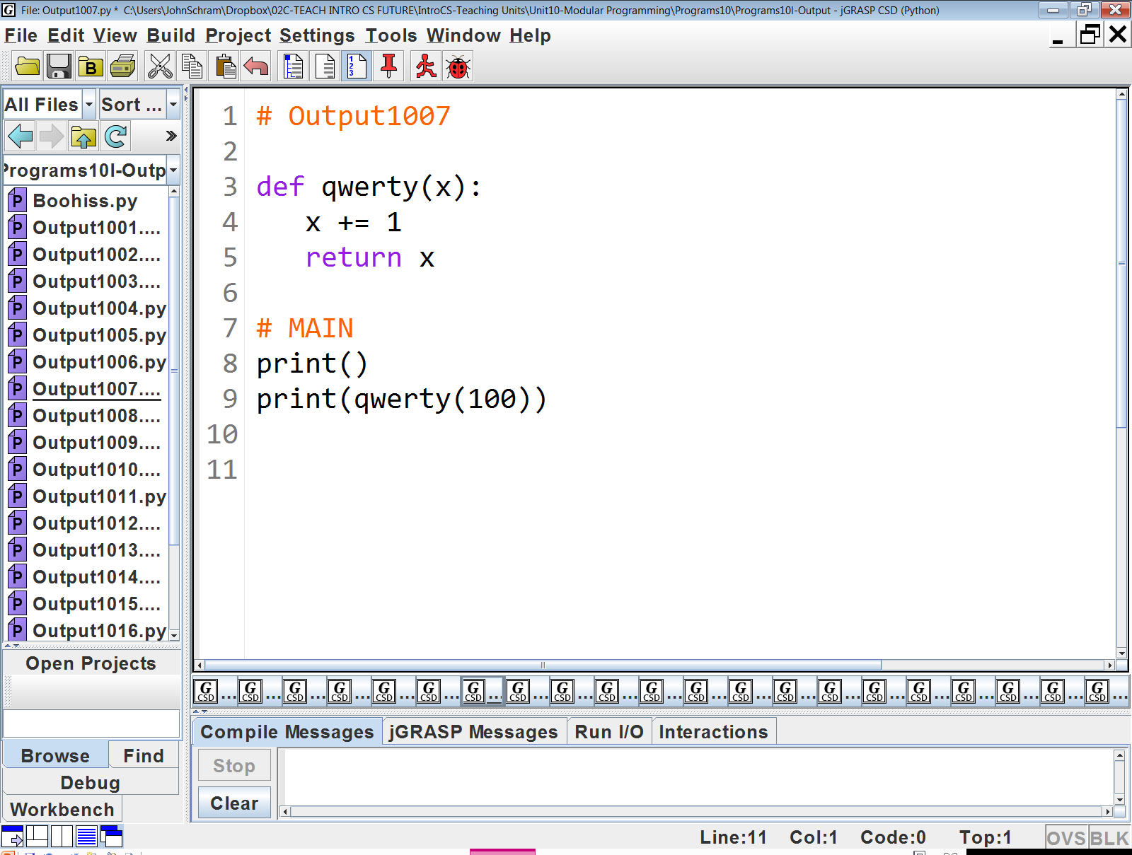

Slide 11


Slide 13
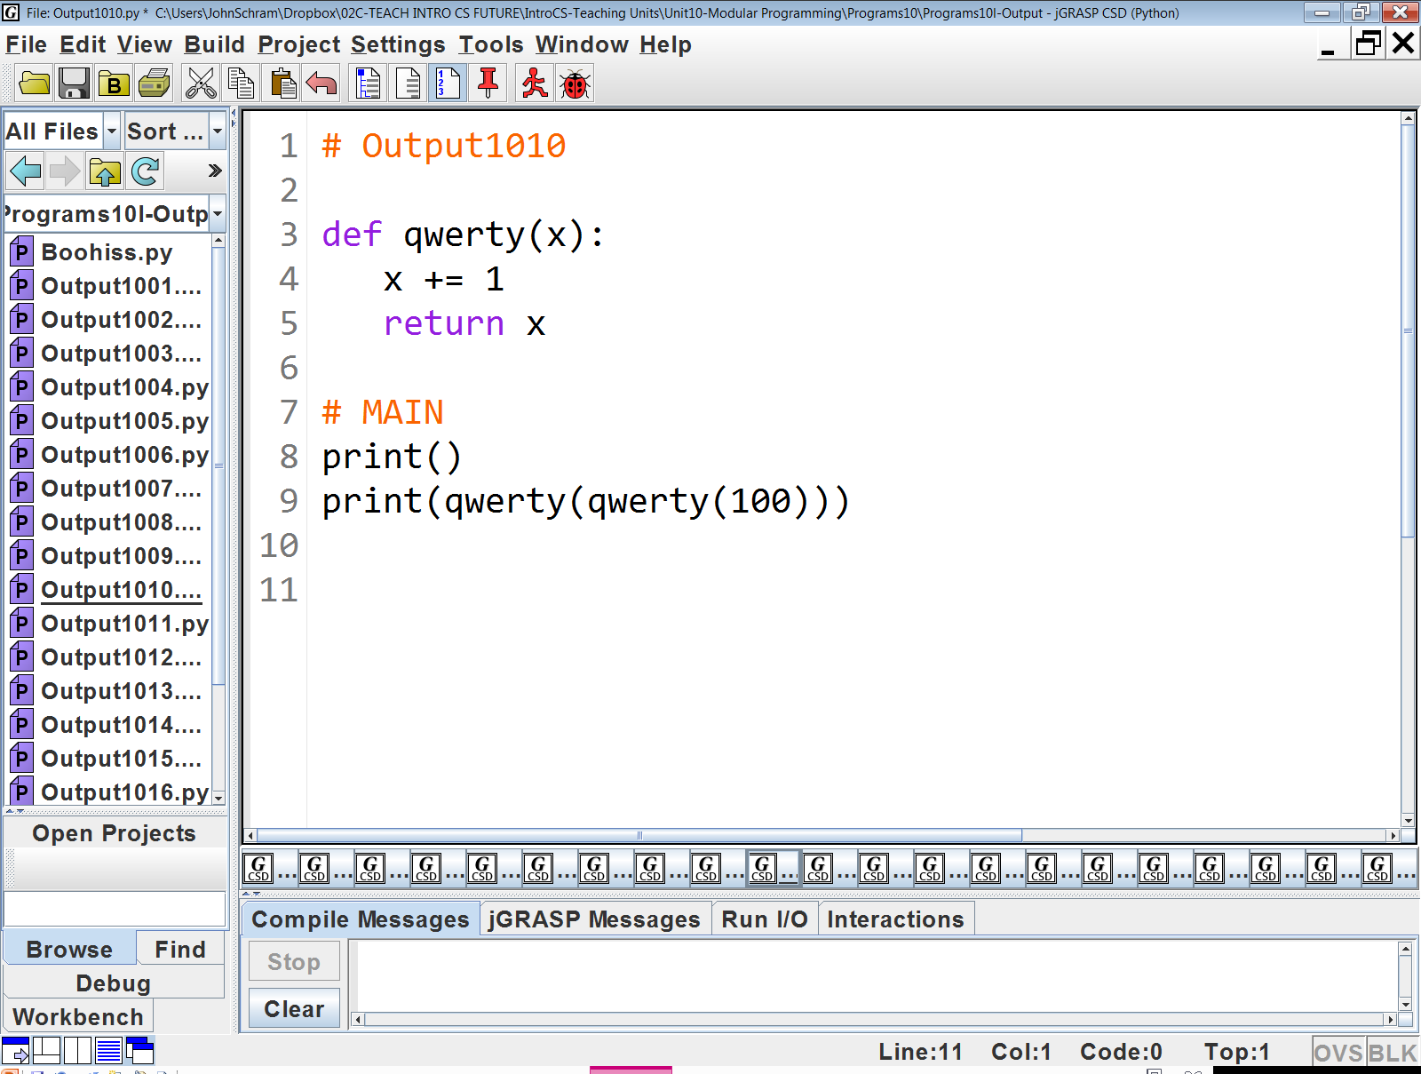

Slide 14
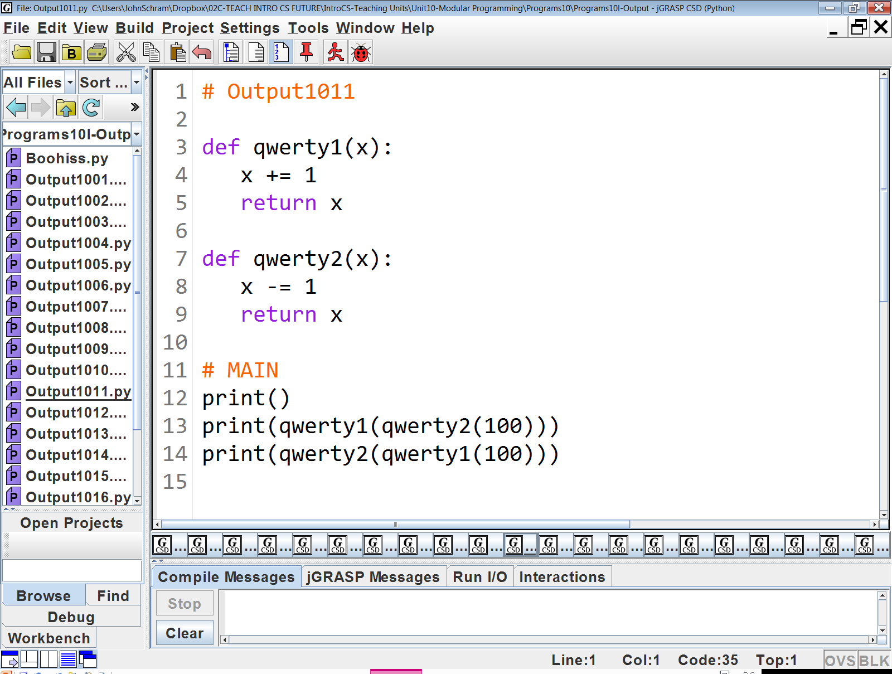

Slide 15
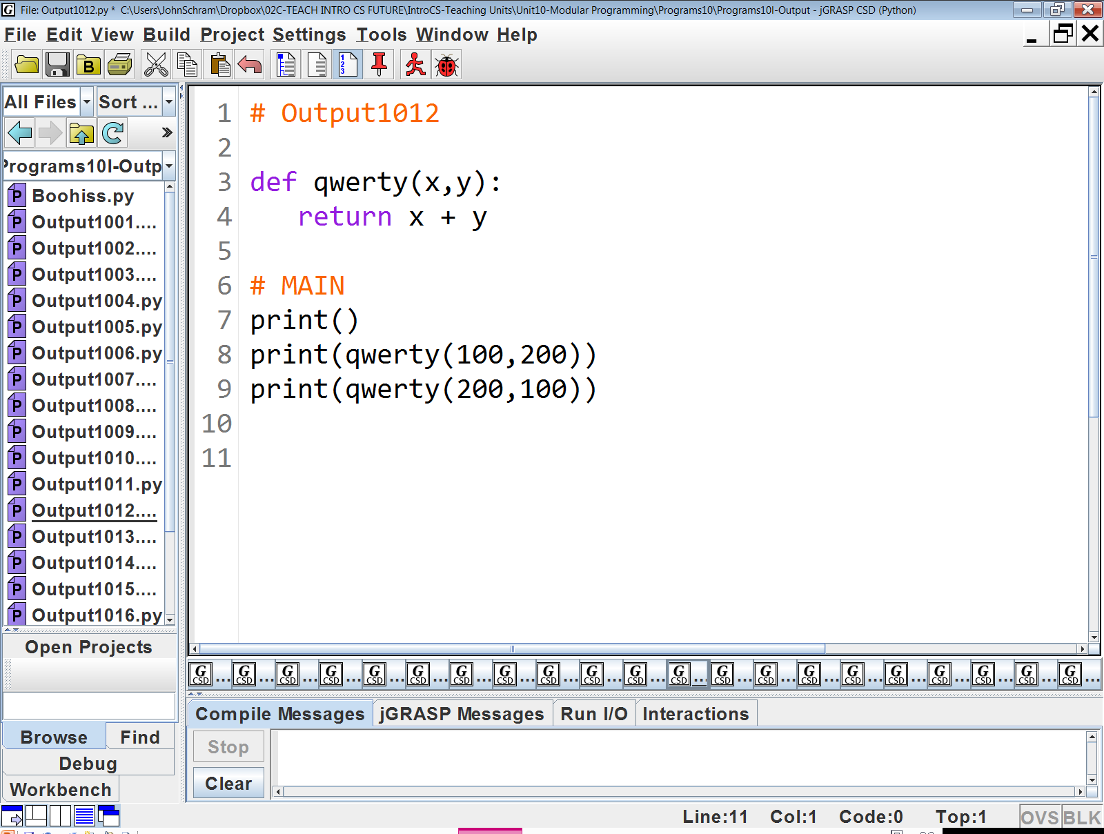

Slide 16


Slide 17
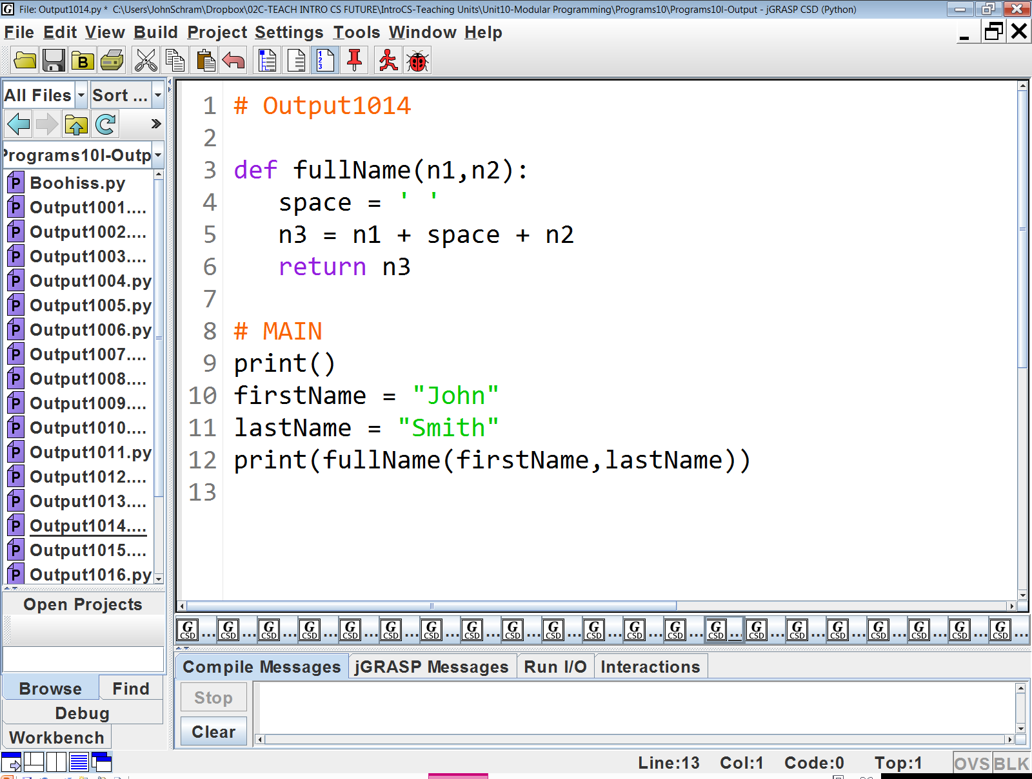

Slide 18
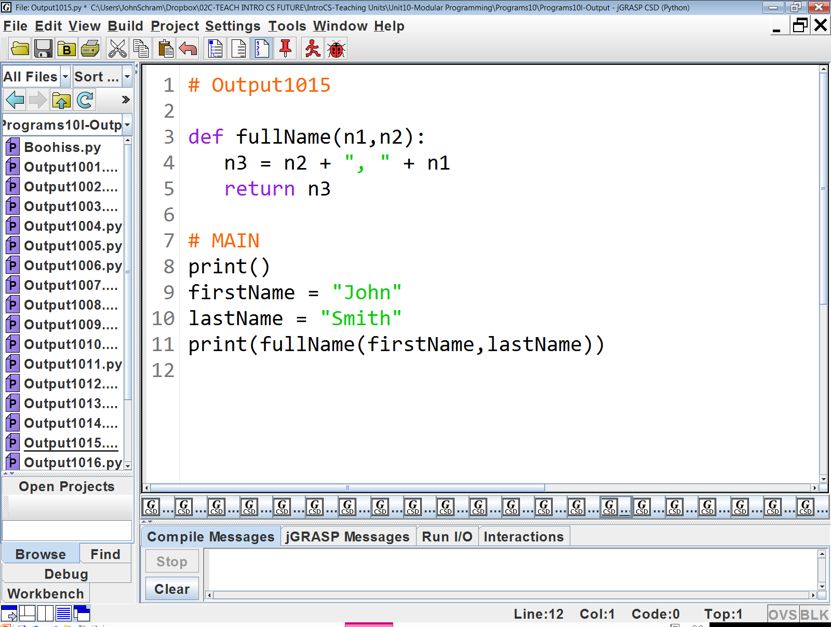

Slide 19
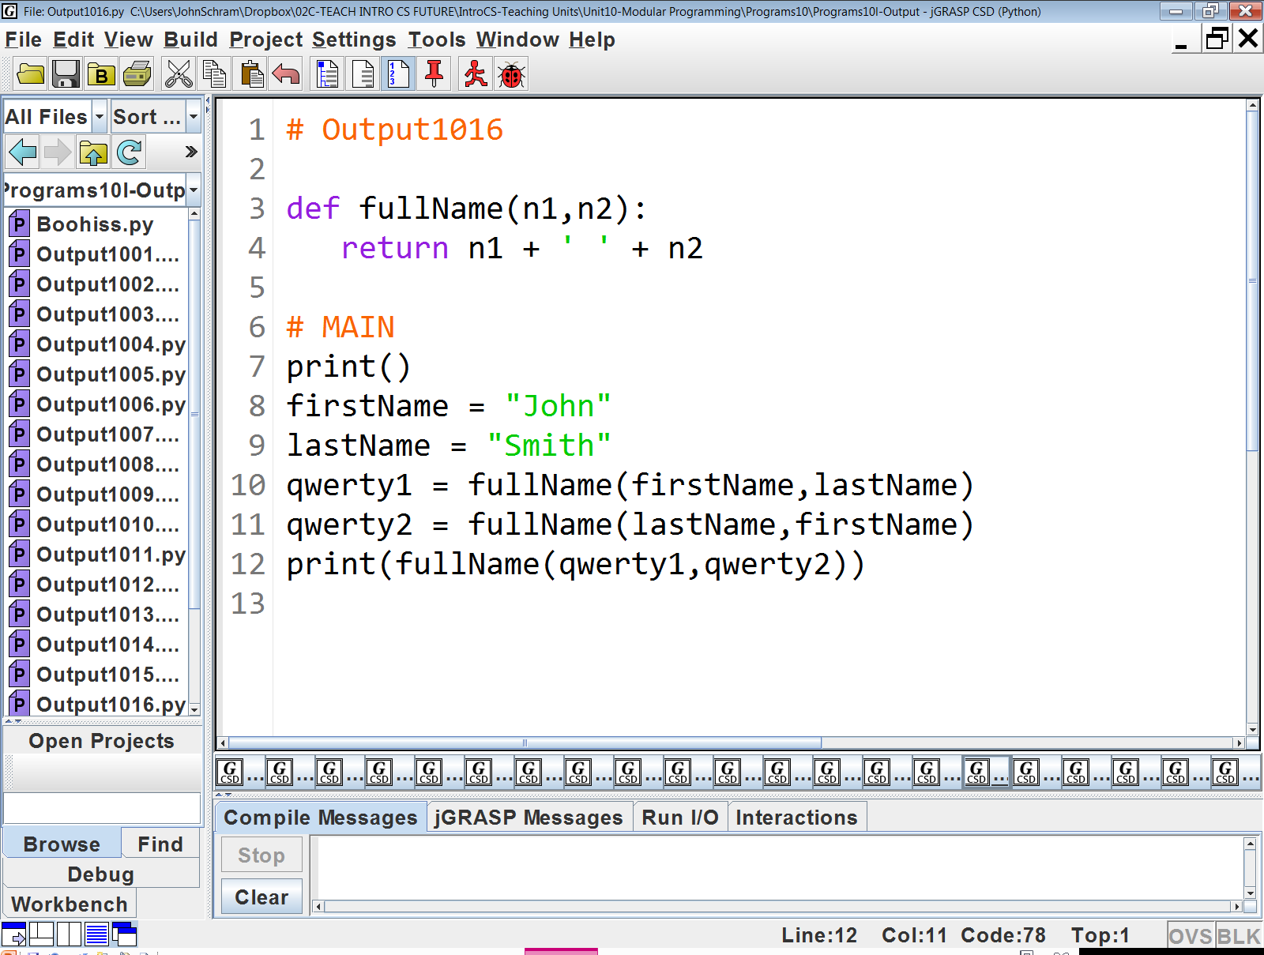

Slide 20
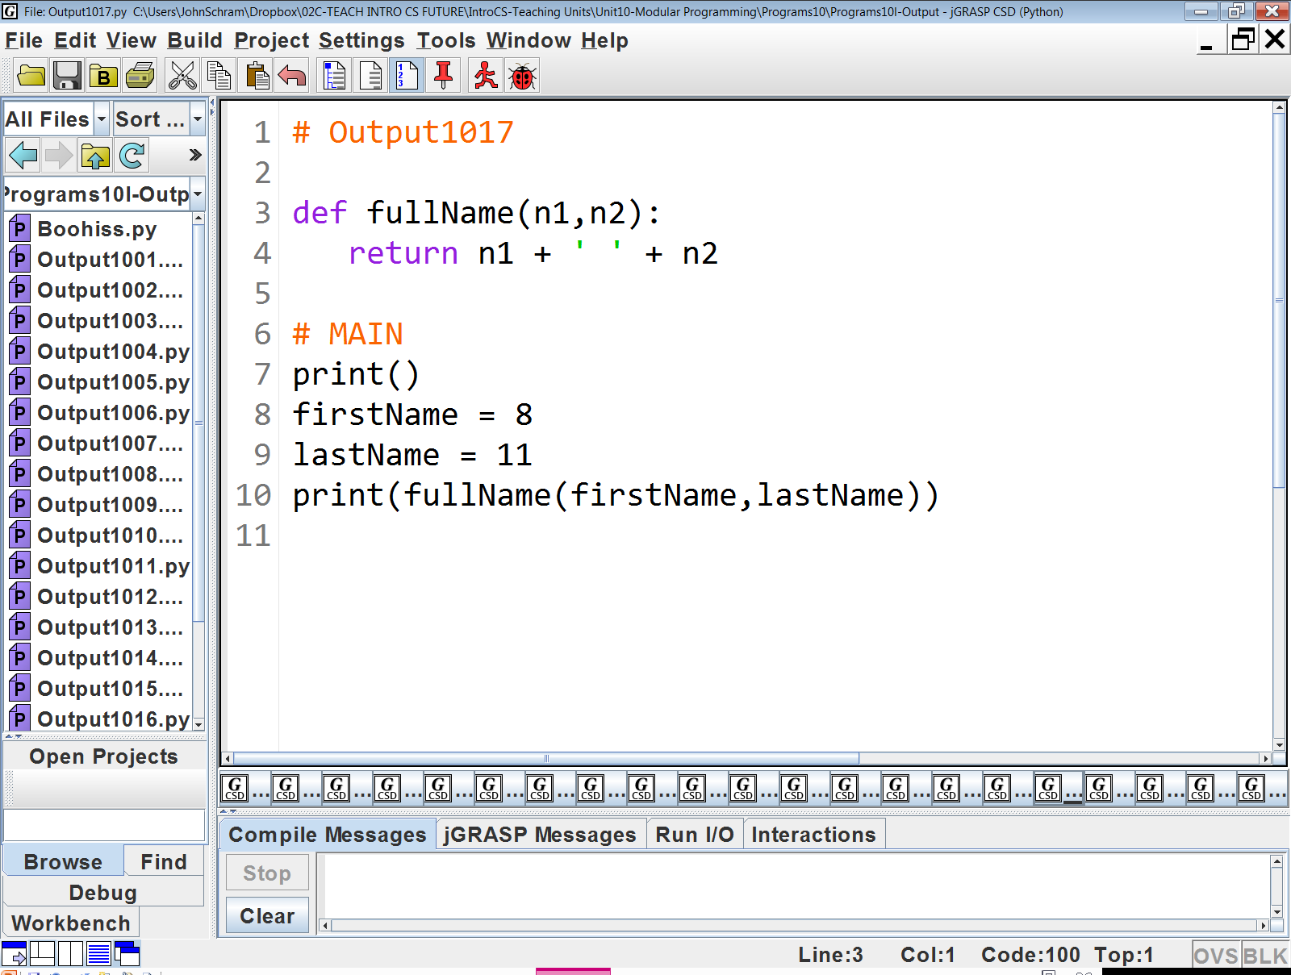

Slide 21
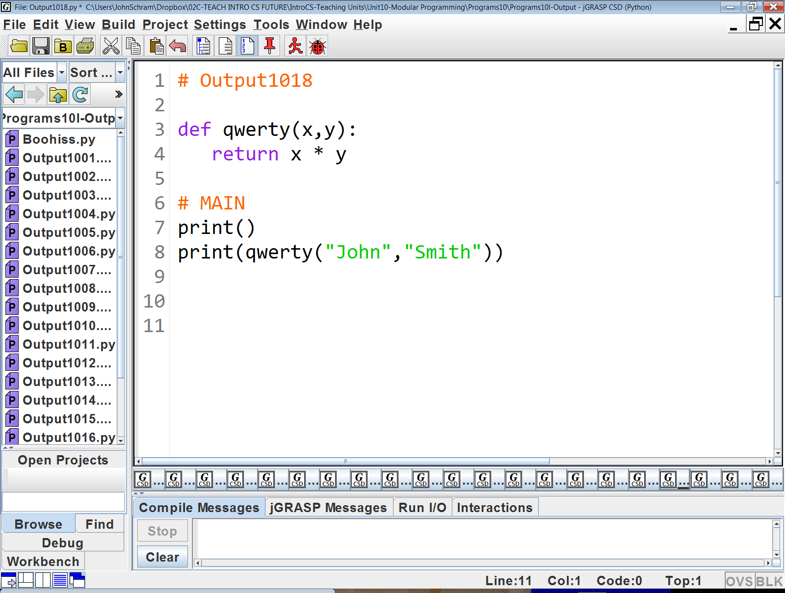

Slide 22
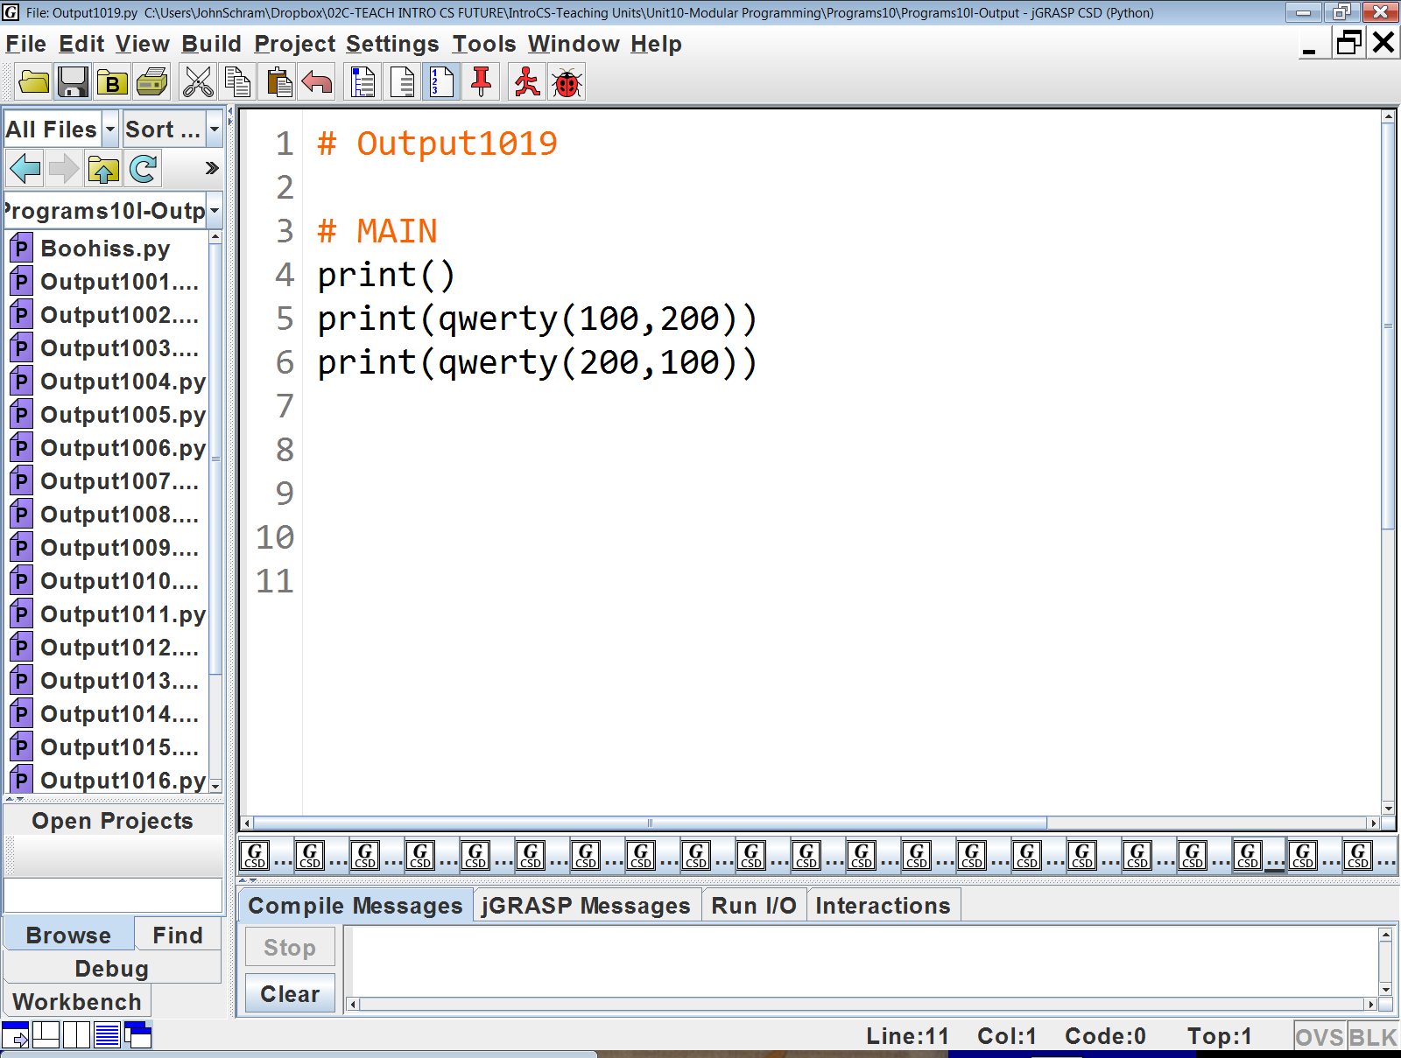

Slide 23
